Slide 1



Sales Report
View in Power BI
Last data refresh:
19/07/2024 22:00:50 UTC
Downloaded at:
22/07/2024 23:06:19 UTC

Slide 2
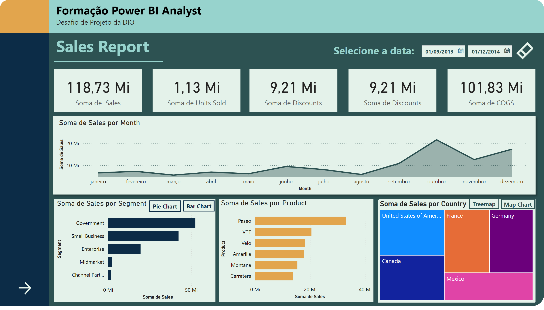
Página 1
Notes:
shape
No alt text provided
shape
No alt text provided
shape
No alt text provided
shape
No alt text provided
textbox
No alt text provided
shape
No alt text provided
shape
No alt text provided
shape
No alt text provided
shape
No alt text provided
shape
No alt text provided
textbox
No alt text provided
shape
No alt text provided
shape
No alt text provided
shape
No alt text provided
shape
No alt text provided
shape
No alt text provided
clusteredBarChart
No alt text provided
actionButton
No alt text provided
areaChart
No alt text provided
card
No alt text provided
card
No alt text provided
card
No alt text provided
card
No alt text provided
card
No alt text provided
clusteredBarChart
No alt text provided
map
No alt text provided
slicer
No alt text provided
textbox
No alt text provided
actionButton
No alt text provided
Botão - treemap
No alt text provided
Botão - map
No alt text provided
Botão - bar
No alt text provided
Botão - pie
No alt text provided
donutChart
No alt text provided
treemap
No alt text provided

Slide 3
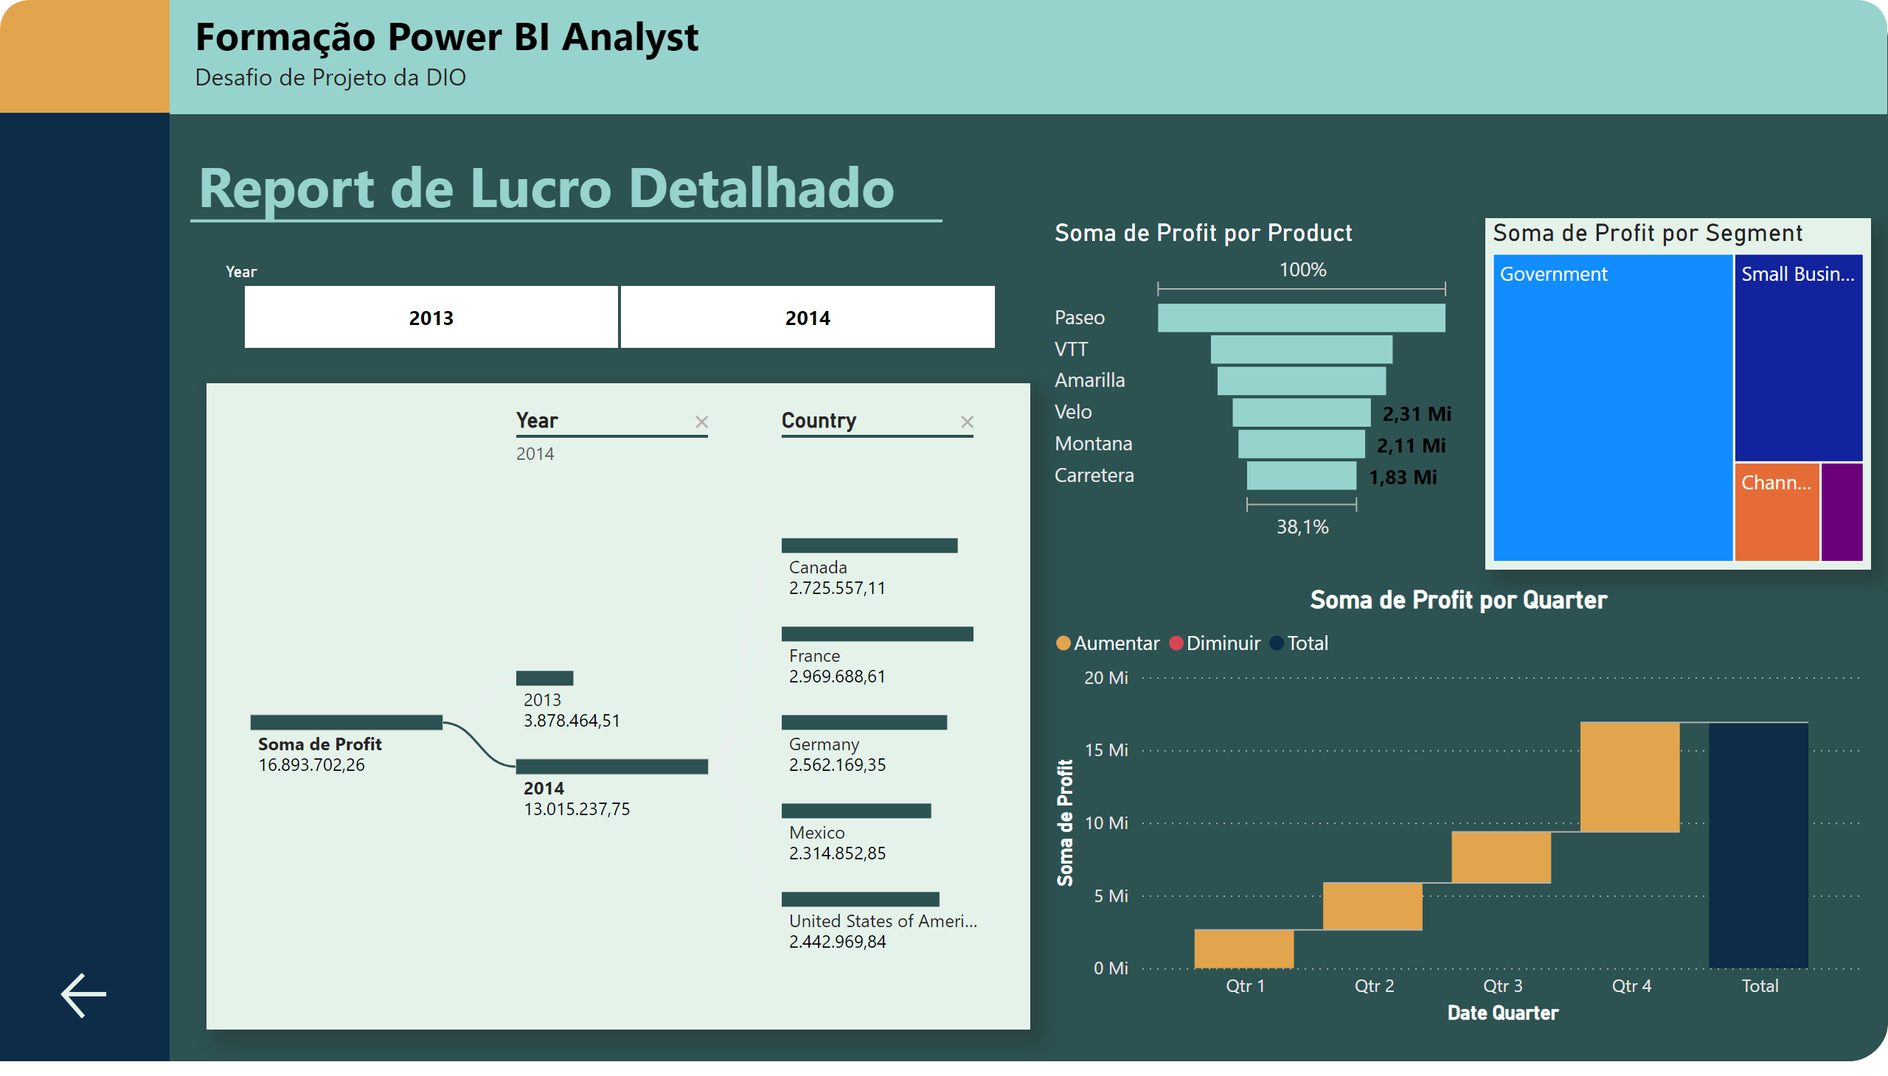
Página 2
Notes:
funnel
No alt text provided
treemap
No alt text provided
waterfallChart
No alt text provided
decompositionTreeVisual
No alt text provided
actionButton
No alt text provided
shape
No alt text provided
shape
No alt text provided
shape
No alt text provided
shape
No alt text provided
textbox
No alt text provided
slicer
No alt text provided
textbox
No alt text provided
shape
No alt text provided

